Slide 1

CROPMON
Project Overview
Tadhg Ó Conghaile
20091418

Slide 2
Functional Description
This project is a plant monitoring prototype.
It sends a notification to a phone when a plant requires watering.
Notification turned on
Sensor polled every hour
Notification sent to phone when no moisture is detected

Slide 3
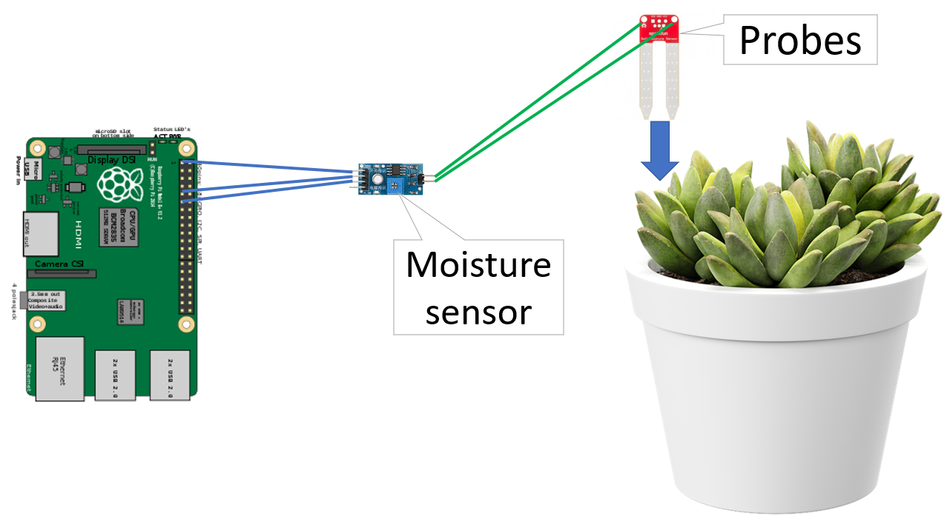
Hardware Overview

Slide 4




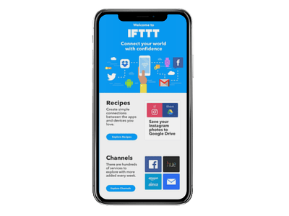
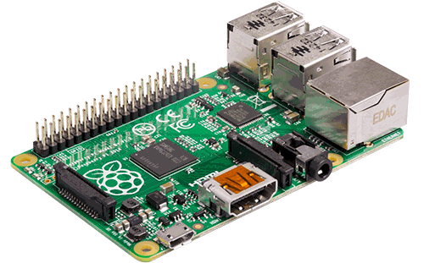
Communications
Subscribe
Requests
Publish
Notification
Widget

Slide 5
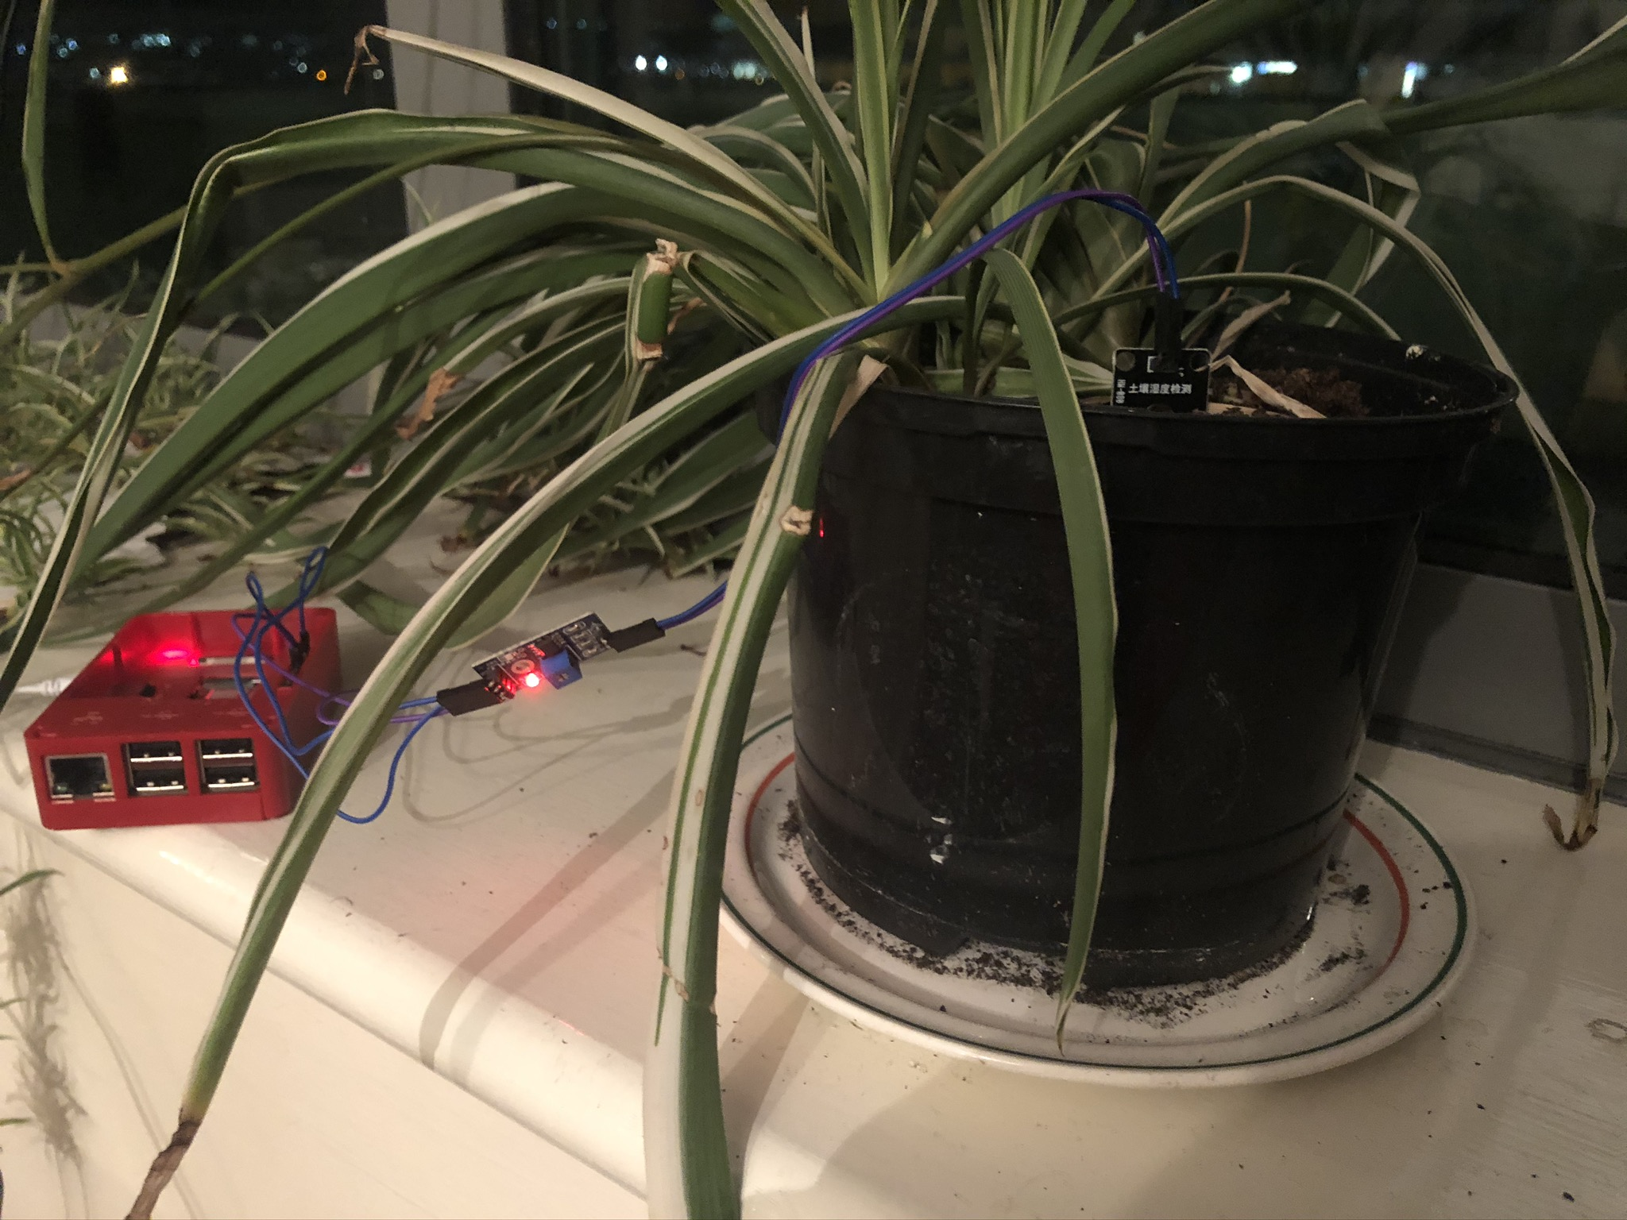
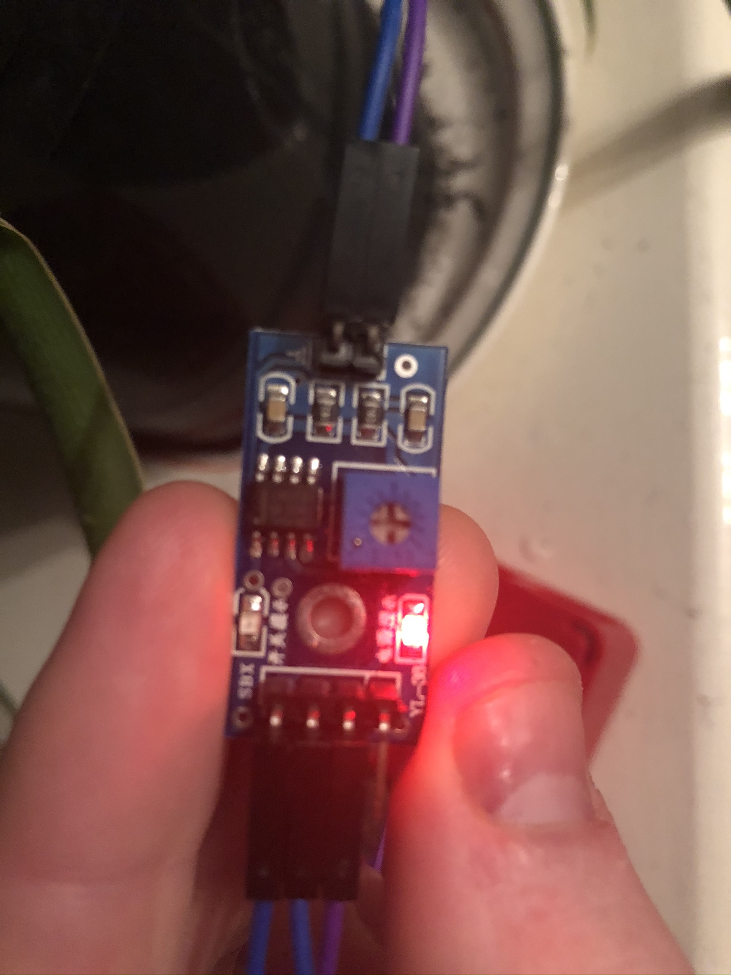
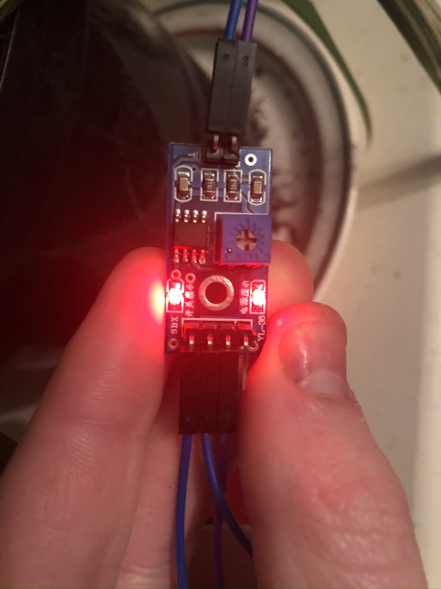
Hardware
No moisture
Moisture

Slide 6
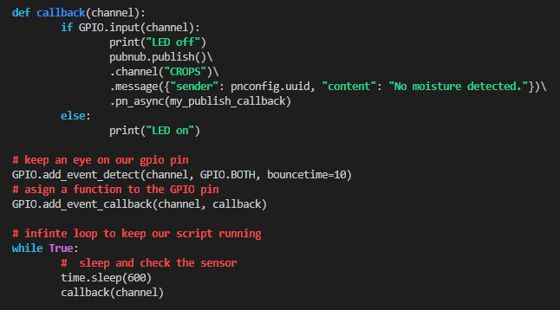
Python Script
cropmon_client.py
Function called every hour
If no moisture, publish a message
If moisture, do nothing
Loop to keep the program running

Slide 7
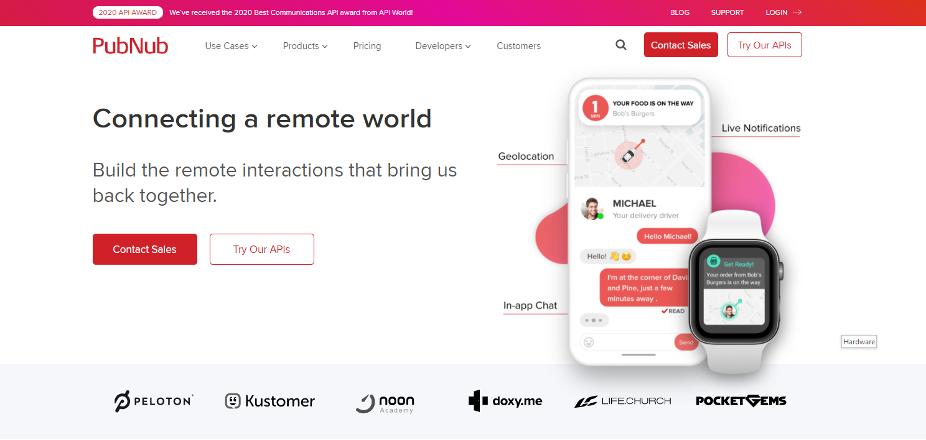
PubNub
https://www.pubnub.com/

Slide 8
NodeJS server
https://cropmon.azurewebsites.net/
index.js – Starts the app and handles API calls to turn on the notification
pubsub.js – Listens for messages and then triggers the IFTTT notification via web request

Slide 9
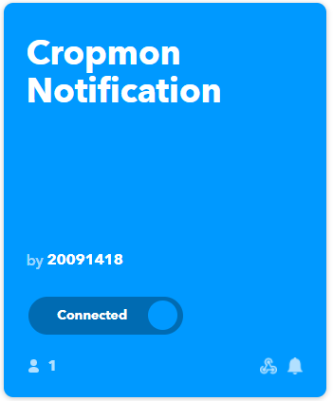
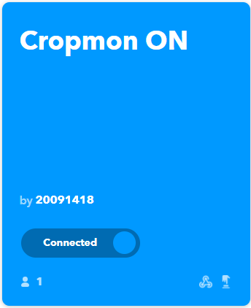
IFTTT
Triggered via Webhook by Node server. Sends notification to iPhone
Triggered via iPhone Widget. Sends POST request to Node Server

